Slide 1
Key Papers for Thoracic Surgeons
March 9, 2019
General Thoracic Surgical Club
Linda W. Martin, MD, MPH
Notes:
Good Morning
For all the resources and effort that go into clinical trials, penetration into practice and changes in practice across all medical specialties is suboptimal.
One of the legacy committees of ACOSOG within Alliance is Dissemination and Implementation.
Last year we had a session on “what happened to that trial?”
This year we don’t have results of NCI sponsored trials, there are many that are forthcoming.
we In the meantime we thought it would be instructive to the group to give follow up on results of recently completed trials.

Slide 2
No Disclosures

Slide 3
Top Articles in Major Journals
Goal to identify practice changing articles
Also “trending” articles that you “should” know about
DID NOT INCLUDE:
NELSON trial – Gail Darling presented yesterday
CHEST articles
JTO articles
Many breakthrough findings in stage 4 lung cancer
Thank you to Mark Ferguson and Reza Mehran for their help compiling this list
Notes:
Word of mouth
Major journals – top read/downloads/top cited
PulmX metrics
Consulted with Mark Ferguson – CTS net journal and news scan

Slide 4
Notes:
but we had unique challenges for thoracic surgery

Slide 5
New England Journal of Medicine

Slide 6
Jan 10 2019

Slide 9
Pacific Trial Survival Outcomes –2018

Slide 10
Epub 9/2018, print Dec 2018

Slide 11
April 2018
105 citations

Slide 12
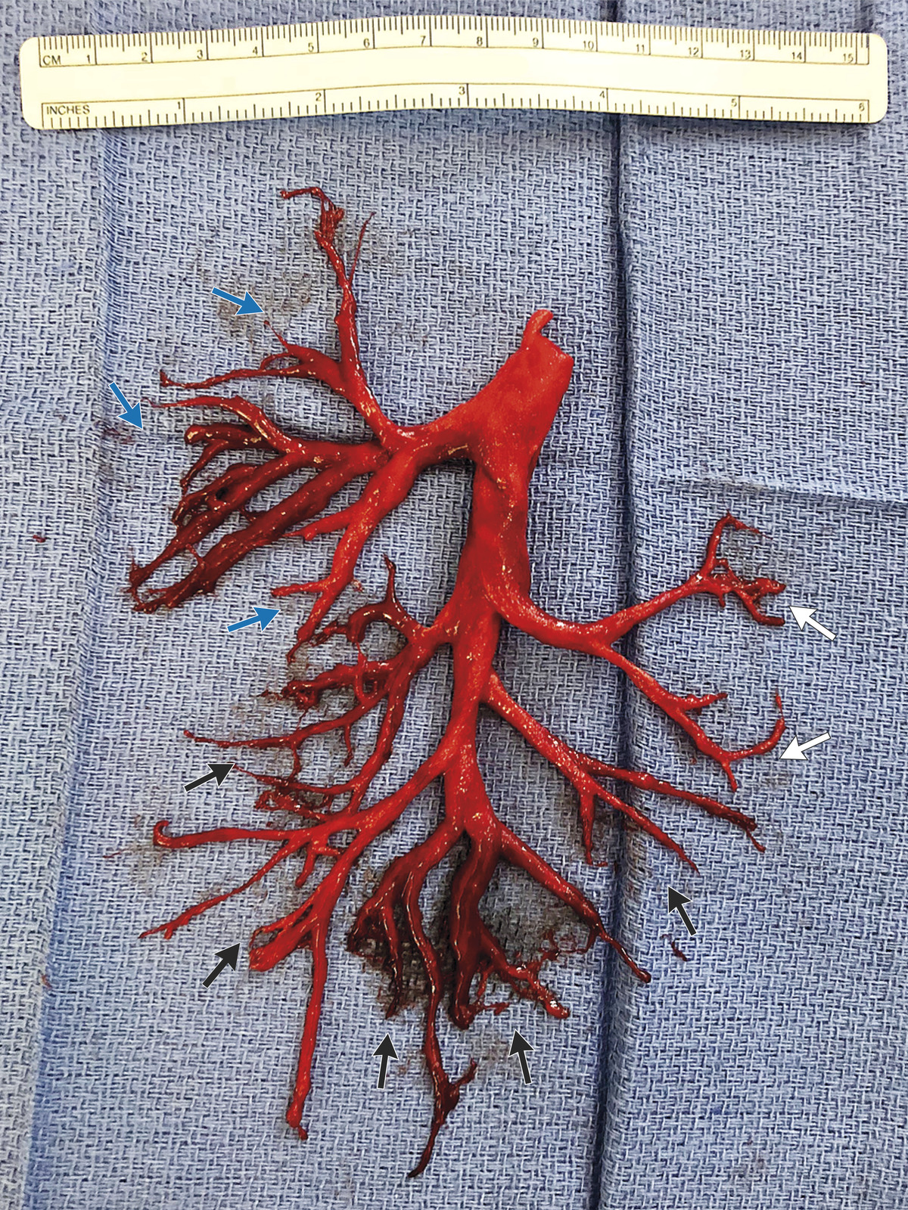
November 29, 2018 N Engl J Med 2018; 379:2151

Slide 13
November 15, 2018 N Engl J Med 2018; 379:1895-1904 DOI: 10.1056/NEJMoa1806395

Slide 14
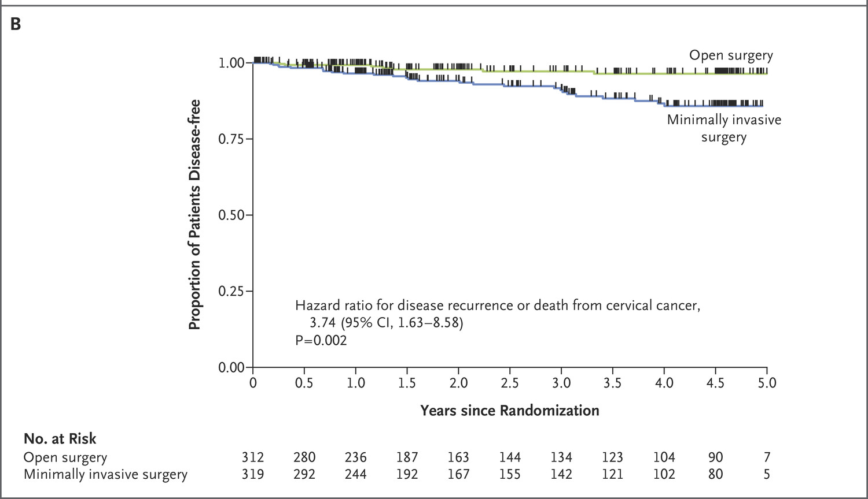
PT Ramirez et al. N Engl J Med 2018;379:1895-1904.
Estimates of Disease-free Survival.
Notes:
Figure 1. Estimates of Disease-free Survival. Minimally invasive surgery indicates laparoscopic or robot-assisted radical hysterectomy, and open surgery indicates open abdominal radical hysterectomy. Panel A shows the difference in disease-free survival rates between surgical groups at 4.5 years after surgery for both the intention-to-treat and per-protocol populations. The dashed line denotes the noninferiority margin of −7.2 percentage points. Noninferiority of minimally invasive surgery would be declared if the lower boundary of the two-sided 95% confidence interval were above this margin (i.e., to the right of this line). The P value for noninferiority is two-sided. Panel B shows the Kaplan–Meier disease-free survival curves for the surgical groups. The hazard ratio, 95% confidence interval, and corresponding P value were estimated with the use of Cox proportional-hazards models. Tick marks indicate censored data. Disease recurrence or death from cervical cancer occurred in 27 of 319 patients in the minimally invasive surgery group and 7 of 312 patients in the open-surgery group.

Slide 15
JAMA Surgery

Slide 16
Path CR rate unknown after SBRT
Phase II single arm study, T1-2N0
Neoadjuvant SABR then wedge or lobe 10 weeks later

Slide 21
Journal of the American College of Surgeons

Slide 22
5 top Plumx articles on attire in the OR!

Slide 24
Journal of Clinical Oncology

Slide 25
Second most read JCO paper of the year

Slide 27
JTCVS 2018-2019 “top” articles in thoracic

Slide 29
October 2017

Slide 31
Annals of Thoracic Surgery

Slide 32
Fourth highest rated PlumX paper for 2017-2019
All the rest are cardiac surgery

Slide 33
Comparison of Neoadjuvant Chemotherapy Followed by Surgery to Upfront Surgery for Thymic Malignancy
Samina Park, MD, In Kyu Park, MD, PhD, Young Tae Kim, MD, PhD,
Geun Dong Lee, MD, PhD, Dong Kwan Kim, MD, PhD, Jong Ho Cho, MD, PhD, Yong Soo Choi, MD, PhD, Chang Young Lee, MD, Jin Gu Lee, MD, PhD, and
Chang Hyun Kang, MD, PhD, for the Korean Association for Research on the Thymus
1,486 patients with surgically resected thymic malignancies between 2000 and 2013
110 patients (7.4%) underwent surgical resection after neoadjuvant chemo- therapy
propensity score-matched analysis
no signiﬁcant differences in postoperative mortality (p value not calculated), postoperative complications (p [ 0.405), and hospital length of stay (p [ 0.821) between the two groups.
neoadjuvant chemotherapy group showed signiﬁcantly higher transfusion rates (p [ 0.003) and longer operation times (p < 0.001) than the upfront surgery group.
Pathologically complete resection rates (p [ 0.382) and tumor sizes (p [ 0.286) were similar between the two groups. The 5-year overall survival rates were 77.4% and 76.7%, respectively (p [ 0.596). The 3-year recurrence-free survival rates were 62.9% and 71.5%, respectively (p [ 0.070).
Conclusions. Neoadjuvant chemotherapy, followed by resection, obtained similar resectability and long-term survival rates to those of upfront surgery. Therefore, the role of neoadjuvant chemotherapy should be reﬁned in randomized controlled trials.
(Ann Thorac Surg 2019;107:355–62)
© 2019 by The Society of Thoracic Surgeons

Slide 34
Is There a Role for Cancer-Directed Surgery in Early-Stage Sarcomatoid or Biphasic Mesothelioma?
Samuel Kim, MD, David A. Bull, MD, Linda Garland, MD, Zain Khalpey, MD, PhD, Baldasarre Stea, MD, PhD, Sun Yi, MD, and Charles C. Hsu, MD, PhD
Results. From National Cancer Database queries, 878 patients with clinical stage I or II MPM with sarcomatoid (n [ 524) or biphasic (n [ 354) histology were identiﬁed. Overall median survival was 5.5 months for patients with sarcomatoid mesothelioma. The cancer-directed surgery improved overall survival compared with no operation
(median survival, 7.56 months vs 4.21 months, respec- tively; p < 0.01). In the biphasic group, median overall survival was 12.2 months. Again, the cancer-directed surgery improved survival compared with no operation (15.8 months vs 9.3 months, p < 0.01). For both histologies, the cancer-directed surgery improved overall survival compared with those who underwent chemotherapy or radiotherapy, or both, without resection (p < 0.05). Peri- operative mortality was 6.0% at 30 days and 21.4% at 90 days.
Conclusions. The cancer-directed surgery is associated with improved survival in early-stage MPM patients with nonepithelioid histology compared with those who did not undergo resection or chose medical therapy. Given the high perioperative mortality, a careful patient selection and multidisciplinary evaluation is recommended.
(Ann Thorac Surg 2019;107:194–201)
© 2019 by The Society of Thoracic Surgeons

Slide 35
Chemo + ipi (13 patients) vs. historical chemo alone (42 patients)
Stage II - IIIA

Slide 37
559 patients with cstage 1 lung cancer, lobectomy
206 case-matched pairs

Slide 38
The Annals of Thoracic Surgery 2018 106, 1499-1503DOI: (10.1016/j.athoracsur.2018.06.070)
Copyright © 2018 The Society of Thoracic Surgeons Terms and Conditions

Slide 39
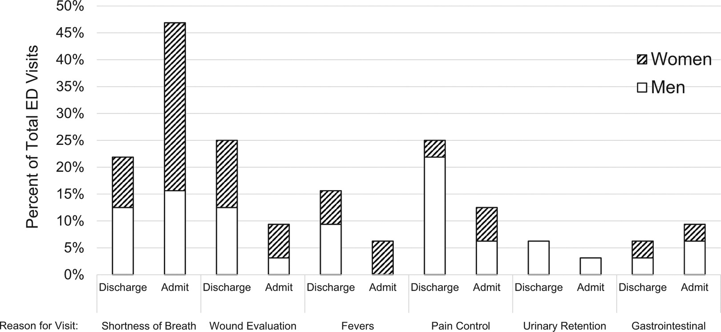
Fig 1
The Annals of Thoracic Surgery 2018 106, 1499-1503DOI: (10.1016/j.athoracsur.2018.06.070)
Copyright © 2018 The Society of Thoracic Surgeons Terms and Conditions
Notes:
Reason for emergency department (ED) visit and rate of unplanned admission within 30 days after discharge.

Slide 40
Anatomic lung resection
Randomized to digital or analog system

Slide 41
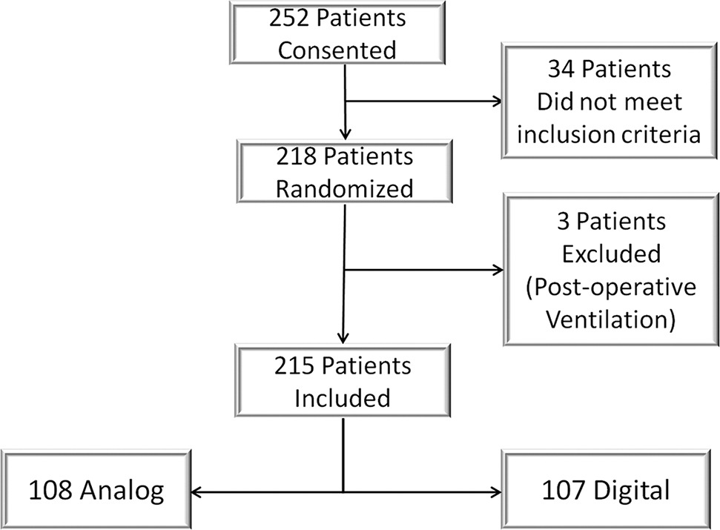
Fig 1
The Annals of Thoracic Surgery 2018 106, 1628-1632DOI: (10.1016/j.athoracsur.2018.06.080)
Copyright © 2018 The Society of Thoracic Surgeons Terms and Conditions
Notes:
Flow diagram of patients in the trial.

Slide 42
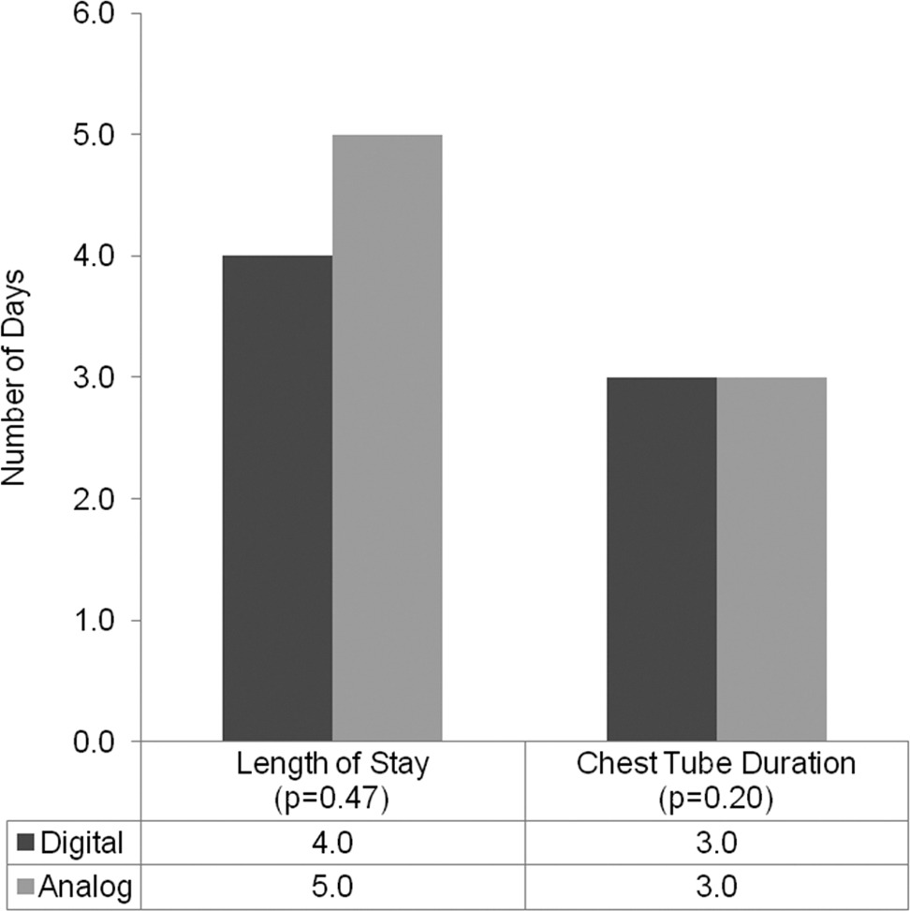
Fig 2
The Annals of Thoracic Surgery 2018 106, 1628-1632DOI: (10.1016/j.athoracsur.2018.06.080)
Copyright © 2018 The Society of Thoracic Surgeons Terms and Conditions
Notes:
Comparison of length of stay and chest tube duration for patients with digital (n = 107) and analog (n = 108) devices. The interquartile range (IQR) for median length of stay was (3 to 7), and (3 to 7) for the digital and analog groups, respectively. The IQR for median chest tube duration was (2 to 5), and (3 to 5) for the digital and analog groups, respectively.

Slide 43
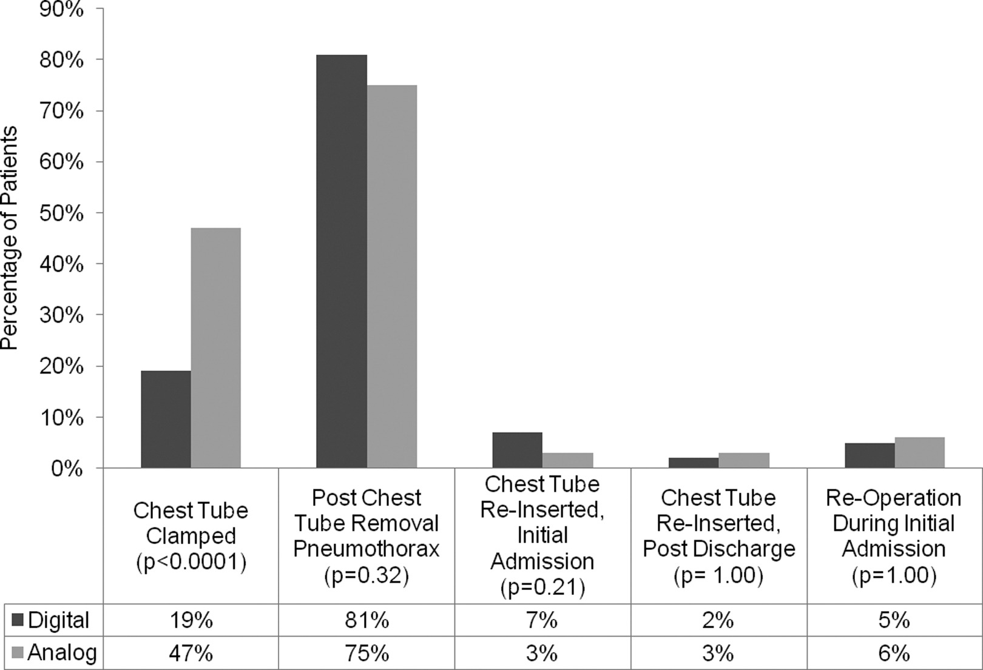
Fig 3
The Annals of Thoracic Surgery 2018 106, 1628-1632DOI: (10.1016/j.athoracsur.2018.06.080)
Copyright © 2018 The Society of Thoracic Surgeons Terms and Conditions
Notes:
Comparison of secondary outcomes for patients with digital (n = 107) and analog (n = 108) devices.

Slide 44
Retrospective review 226 patients
Historical groups compared all VATS lobectomy

Slide 45
Other news/noteworthy efforts and resources
Lung Cancer Updates Podcast
CTSnet JANS
Will be starting (Martin, Blackmon, Antonoff)
CTSnet podcasts – convert existing video content to podcast
STS podcasts for patients using patient portal content

Slide 46
Thanks for another great GTSC meeting! See you at the Super Bowl tonight lm6yb@virginia.edu

